Slide 1
Blockchain-based Sanitary Dignity For Disadvantaged Girls/Women In Africa
Periods With Dignity, Powered By Blockchain
Date: 27 July 2024
Institution: BlockTech Solutions
Capstone Project For: Blockchain Studies (CSC -BSTUD)

Slide 2
Abstract
This capstone project proposes a blockchain-based system to empower school-going girls and unemployed women by providing access to sanitary pads and educational resources on blockchain technology.
This initiative addresses the dual challenges of menstrual hygiene management and digital literacy.
By leveraging blockchain's transparency, security, and efficiency, the project envisions creating a sustainable, decentralized ecosystem that ensures dignity and opportunity for girls and women.
The project will issue a specific token to facilitate transactions and track the distribution of sanitary pads, ensuring that the supply reaches the intended recipients.

Slide 3
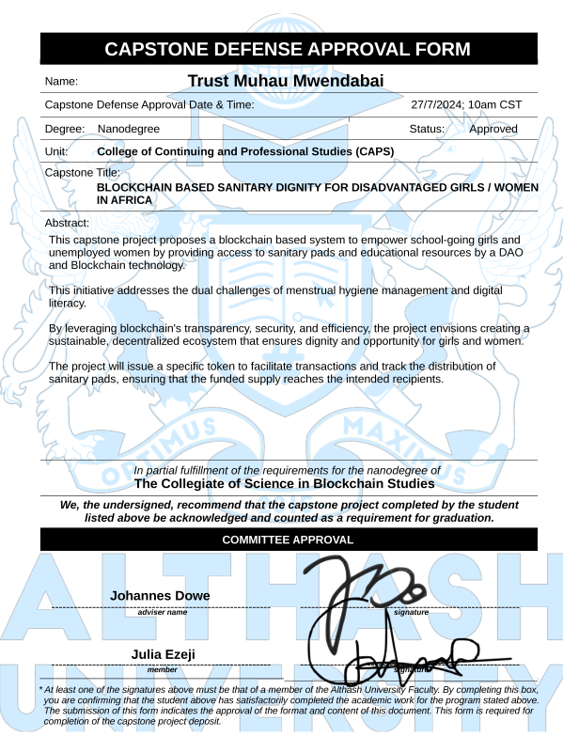
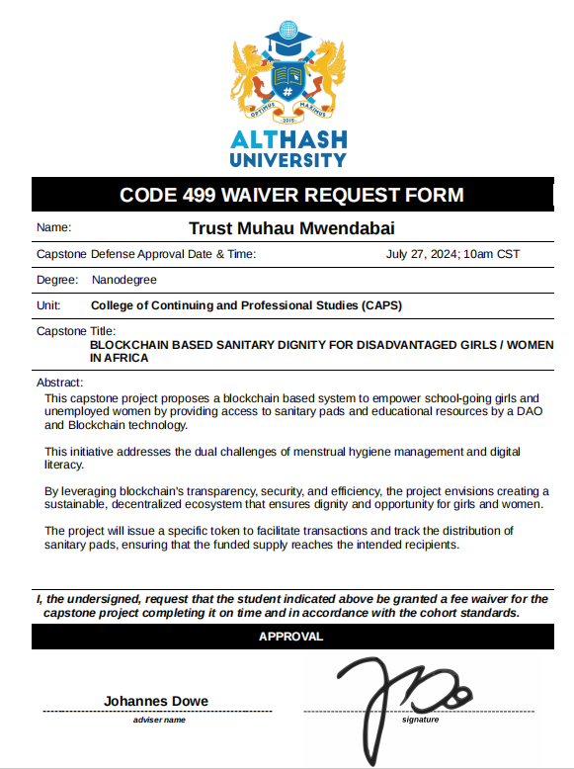

Slide 4
Capstone Defense Approval
Committee Members
1. Lindiwe Manaka
2. Ntombi Mkhosi
3. Nyenyezi Bisimwa
4. Tiny Hambira
5. Trust Muhau Mwendabai

Slide 5

Introduction
Access to sanitary pads is a significant challenge for many girls and women, particularly in developing regions. This issue not only affects their health but also their education and overall well-being. Additionally, the lack of digital literacy, especially regarding emerging technologies like blockchain,limits their opportunities for economic empowerment. This token project we are developing seeks to address these inter-connected problems through an innovative token-based approach that combines hygiene support with technology education.

Slide 6

Problem Statement
Many girls and women in Africa lack access to affordable sanitary pads, leading to health issues and absenteeism from school and work. Simultaneously, there is a significant digital divide, with many girls and women missing out on opportunities in the burgeoning field of blockchain technology.
The lack of transparency in traditional charitable initiatives further exacerbates these issues, as donors often lose trust due to mismanagement of funds. This project proposes a blockchain-based solution to streamline the distribution of sanitary pads ensuring they reach disadvantaged girls in a timely and transparent manner.

Slide 7
Methodology and Solution To The Problem
The process involves:
Creating The System For Sanitary Pad Access.
This project will develop a blockchain-based token system to address the problem of distribution of pads in Africa through use of a dedicated token.
The blockchain system will ensure accurate tracking and facilitating of transactions,ensuring transparency and accountability.

Slide 8
Effective Accounting And Financial Management
Accounting System are crucial for our Token to ensure transparency and efficient use of resources. Establishing a DAO will:
Develop a robust financial management system to track donations, expenditures, and distribution of sanitary pads.
Implement regular financial audits to maintain transparency and build trust with stakeholders and donors.
Create financial reports that are publicly accessible through the blockchain, enhancing accountability.

Slide 9
DAO Second Token Development
The DAO members will also contribute to and vote on various aspects of the project.
Developing a second token (SHE-VOTE) for DAO voting to ensure community-driven decisions.

Slide 10
Establishing Partnerships
Partnering with suppliers, NGOs, government healthcare, and institutions like the Red Cross to facilitate distribution.
Involvement of Government Healthcare, Red Cross, and Other Institutions such as eco-friendly sanitary pad manufacturers to ensure products are sustainable; implementation of a waste management strategy for used sanitary pads, promoting recycling and proper disposal and educating the community on environmentally friendly practices related to menstrual hygiene products.

Slide 11
Partnership In General Will Ensure The Following
Efficient and widespread distribution of sanitary pads.
Integration with existing healthcare programs.
Broader reach and impact through established networks.

Slide 12
Motivation To Encourage Partnerships
To encourage participation our project will offer:
Transparent Impact Tracking
Recognition Media coverage
Partnership Benefits

Slide 13
Track Record and Token Distribution
Girls will access tokens through schools,community centers, and health clinics.
Each girl will receive a set number of sufficient tokens monthly, to cover their menstrual hygiene needs.
Tokens will be distributed based on:
School Attendance
Community Participation
Health Check-Ups

Slide 14
Digital Identification System On Blockchain
Implementing a digital identity system on blockchain for secure and easy access to services.
This will be achieved by integrating technologies such as cybersecurity measures to protect user data and transactions.
There will also be continuous upgrading and scaling of the blockchain infrastructure to accommodate growth and additional features.

Slide 15
Educational Programs & Community Workshops
Needs Assessment
Partnerships
Pilot Programs
Community Engagement
Monitoring and Evaluation

Slide 16
Vision
To ensure every girl/woman in Africa has access to sanitary pads and the opportunity to learn and benefit from blockchain technology.

Slide 17
Mission
Our in-development token project aims to create a sustainable and transparent system that empowers disadvantaged girls and women, ensuring they have the resources and opportunities to thrive in their own personal space.

Slide 18
Goals
Ensure access to sanitary pads for disadvantaged girls and unemployed women in targeted areas.
Educate girls and women on blockchain technology and its applications & benefits.
Foster a transparent and accountable system for managing donations and distribution.

Slide 19
Objectives
Develop and distribute of our in-development tokens.
Establish and manage a DAO for community-driven decision-making.
Partner with key stakeholders to ensure efficient distribution and support.
Launch educational initiatives and workshops on menstrual health and blockchain application system.

Slide 20
Token Name,Ticker & Maximum Supply
Token Name: SpectraPad Token
Token Ticker: SPTPG
Maximum Supply: 1,000,000,000

Slide 21
Project Budget and Allocations $1,600,000
Development and Infrastructure: $500,000
Partnerships and Collaborations: $300,000
Marketing and Outreach: $200,000
Educational Programs: $300,000
Operational Costs: $200,000
Contingency Fund: $100,000

Slide 22
Token Slogan and Description
Slogan: ‘’Smart Pads, Smart Girls’’
Description: The SpectraPad Token (SPTPG) is a blockchain based cryptocurrency token designed to provide disadvantaged girls/women with sanitary pads through innovative blockchain technology but also empowering girls with the knowledge and resources to thrive.
By leveraging smart solutions for pad distribution, the project ensures that girls can focus on their education and personal development, leading to smarter, more capable future leaders.

Slide 23

Project Launch Date And Token Logo
January 1, 2025

Slide 24
Blockchain Oath
I Trust Muhau Mwendabai solemnly swear to uphold the principles of transparency, security, and decentralization inherent in blockchain technology.
We commit to:
Integrity: Conduct all transactions and interactions with honesty and accountability.
Security: Protect the privacy and data of all participants, ensuring robust security measures.
Innovation: Embrace and drive forward technological advancements for the betterment of society.
Decentralization: Support the fair and equitable distribution of power and resources.
Community: Foster collaboration and inclusivity within the blockchain community.
We pledge to use blockchain technology ethically and responsibly, striving to create a more transparent, secure, and just world.

Slide 25
CERTIFICATES and Transcript of Academic Records links: Certificate of Outstanding Competence Certificate of Satisfactory Competence

Slide 26
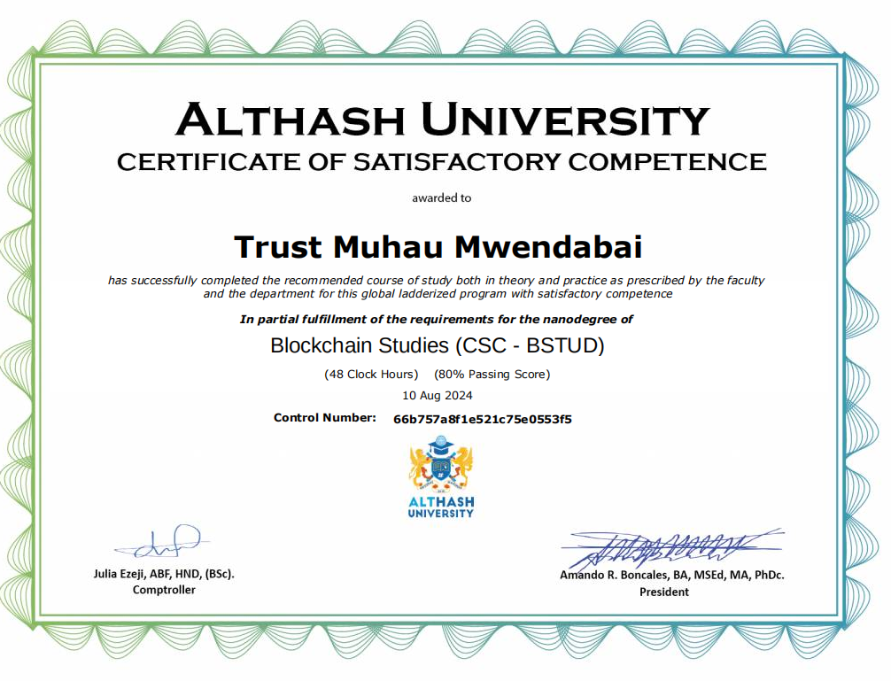

Slide 27
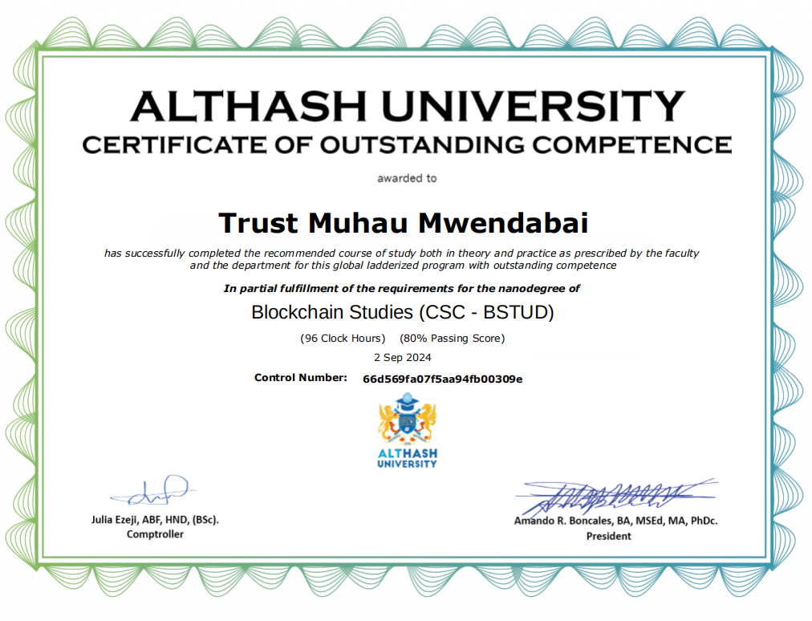

Slide 28
MICROCREDENTIALS BLOCKCHAIN CONTINUED EDUCATION

Slide 29
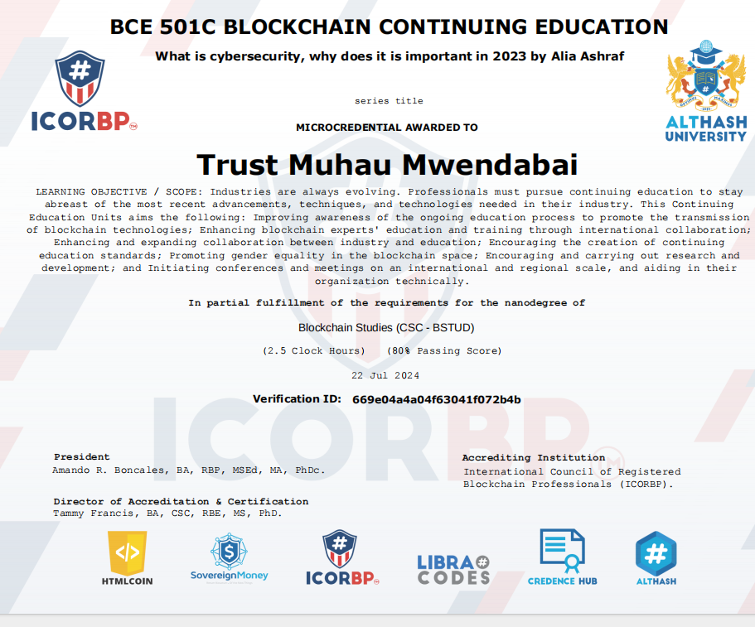

Slide 30
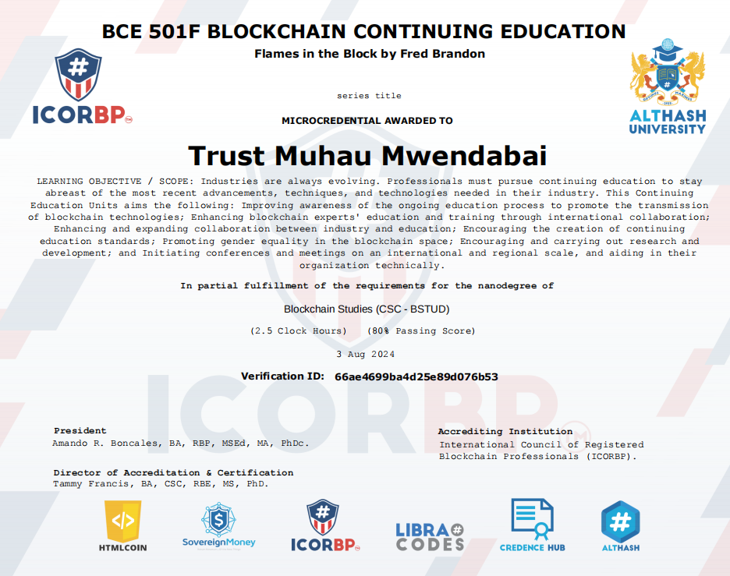

Slide 31
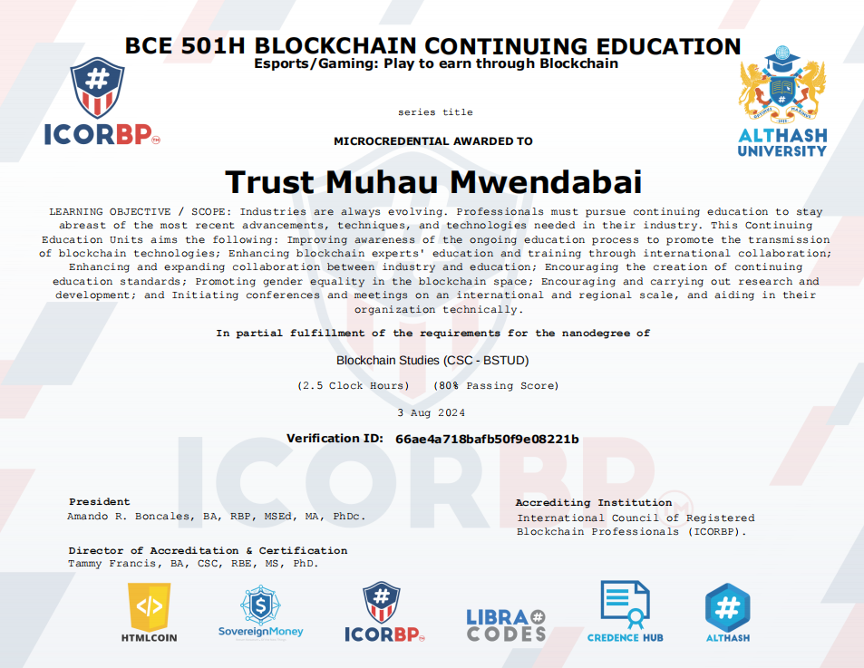

Slide 32


Slide 33
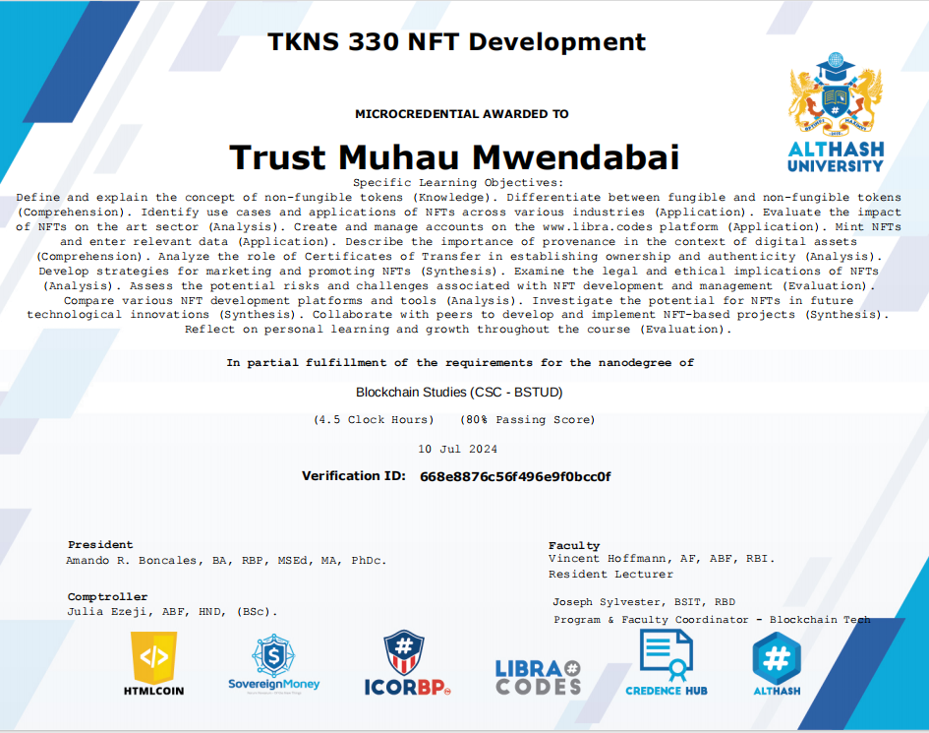

Slide 34


Slide 35


Slide 36


Slide 37
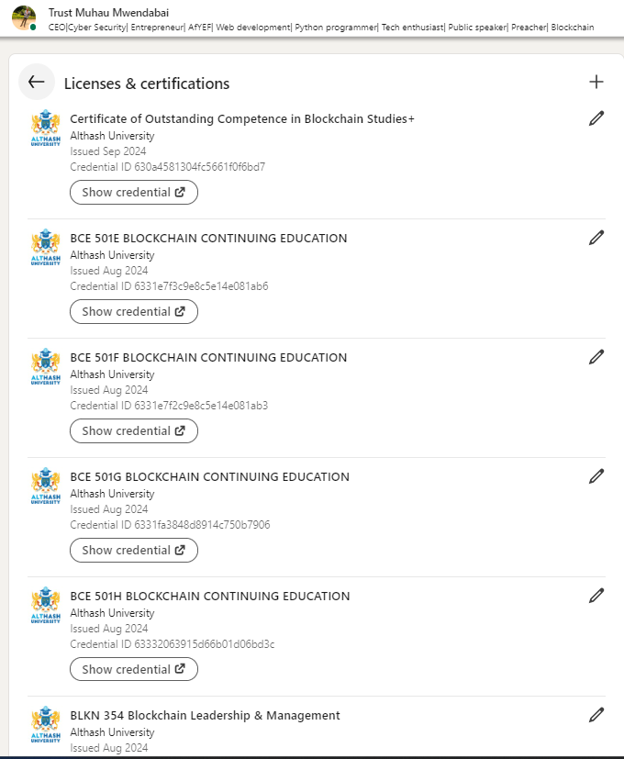
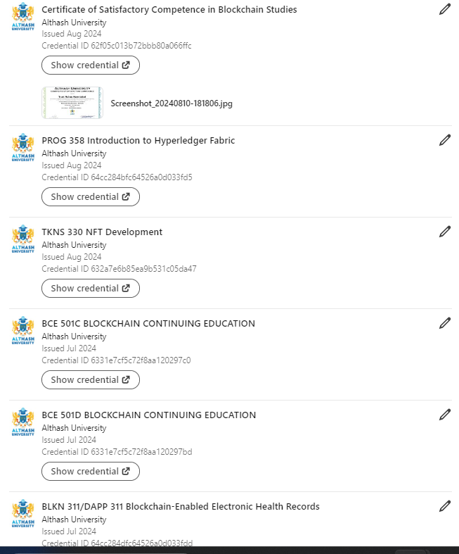
Linkedln upload and link: https://www.linkedin.com/in/trust-muhau-mwendabai/details/certifications/

Slide 38
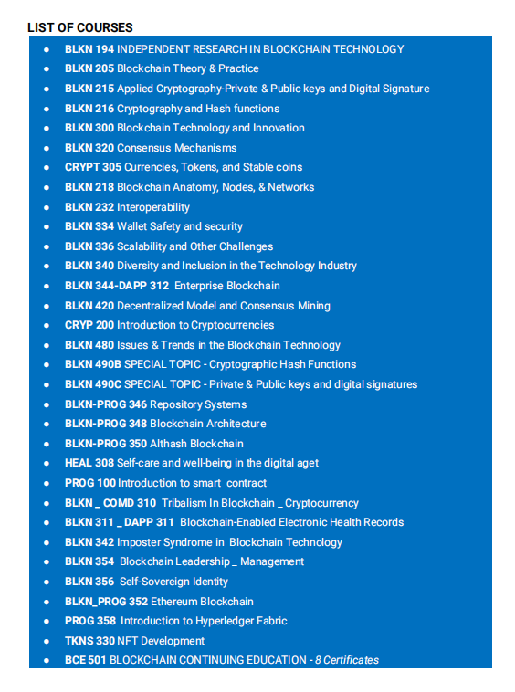

Slide 39
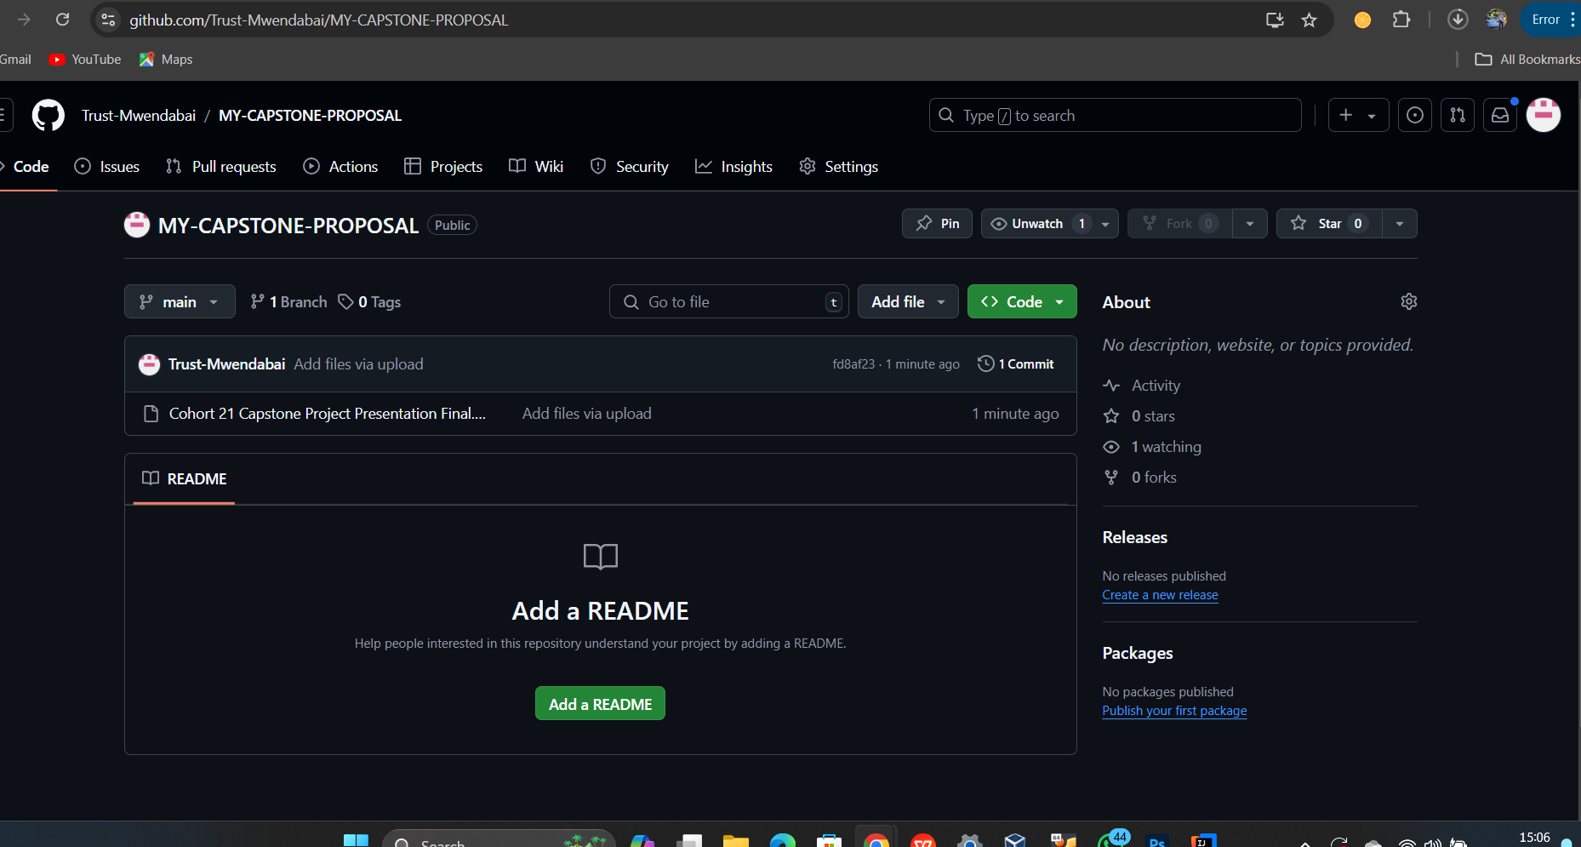
GITHUB LINK https://github.com/Trust-Mwendabai/MY-CAPSTONE-PROPOSAL

